Slide 1
APPLICATION
Personalized Pagerank
web search
community detection
link prediction
anomaly detection
recommendation
Notes:
个性化PageRank（PPR）[24]是最广泛使用的措施之一，因其有效性和理论性质而受到广泛关注

Slide 2
RELATED WORKS
Personalized PageRank Computation
the power iteration
Monte-Carlo
the local update
Parallel Graph Processing
There are many graph processing systems [36, 23, 47, 42, 16] proposed to accelerate graph applications by utilizing GPUs and multi-core CPUs.
the general vertex-centric abstraction

Slide 3
Parallel Personalized Pagerank on Dynamic Graphs
MOTIVATION
sequential execution is still too slow for highspeed stream processing.
Most existing works [39, 22, 6, 5, 30, 31, 29, 11] focus on PPR computation on static graphs
Notes:
动态图上的并行个性化Pagerank [1]。
对于高速流处理，顺序执行仍然太慢。
大多数现有工作[39,22,6,5,30,31,29,11]专注于静态图上的PPR计算

Slide 4
Parallel Personalized Pagerank on Dynamic Graphs
CHALLENGE
First, as the update often comes in batches, it remains unclear if the batch can be updated in parallel for the local update scheme.
Second, parallelizing the local push is non-trivial as it incurs extra overheads compared with a sequential approach.
Notes:
首先，由于更新通常是批量更新，因此仍然不清楚是否可以为局部更新方案并行更新批处理。
其次，并行化局部push是non-trivial的，因为与顺序方法相比，它会产生额外的开销。

Slide 5
Parallel Personalized PageRank on Dynamic Graphs
CONTRIBUTIONS
We introduce a parallel approach to support dynamic PPR computation over high-speed graph streams.
We propose several optimization techniques to improve the performance of the parallel push.
We implement our parallel approach on GPUs and multi-core CPUs.

Slide 6
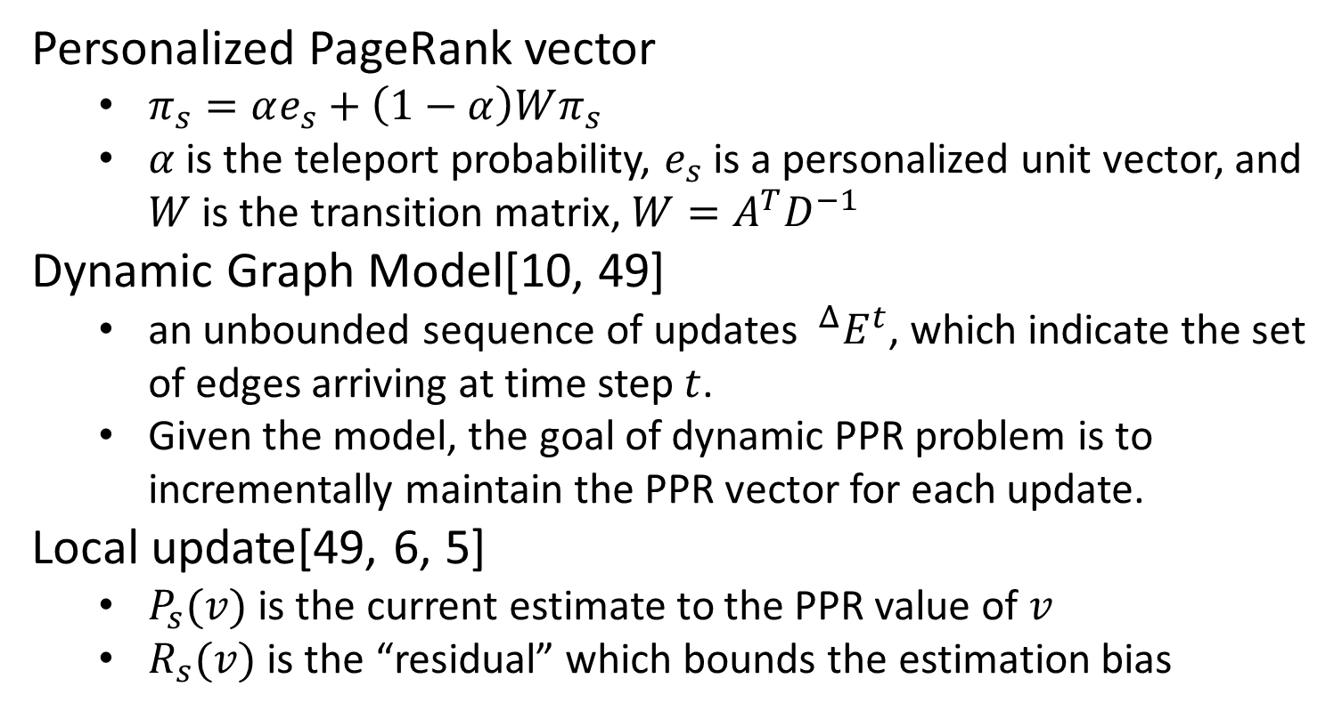
Parallel Personalized PageRank on Dynamic Graphs
Personalized PageRank vector
$π_{s}=αe_{s}+\left(1−α\right)Wπ_{s}$
$α$ is the teleport probability, $e_{s}$ is a personalized unit vector, and $W$ is the transition matrix, $W=A^{T}D^{−1}$
Dynamic Graph Model[10, 49]
an unbounded sequence of updates $^{Δ}E^{t}$, which indicate the set of edges arriving at time step $t$.
Given the model, the goal of dynamic PPR problem is to incrementally maintain the PPR vector for each update.
Local update[49, 6, 5]
$P_{s}(v)$ is the current estimate to the PPR value of $v$
$R_{s}(v)$ is the “residual” which bounds the estimation bias
Notes:
A是邻接矩阵，D是对角矩阵，对角元素是G的所有顶点的出度

Slide 7

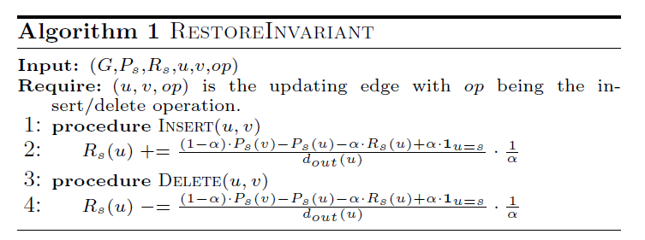
Parallel Personalized PageRank on Dynamic Graphs
Sequential Local Update[49, 6]
restore invariants
perform local pushes

Slide 8
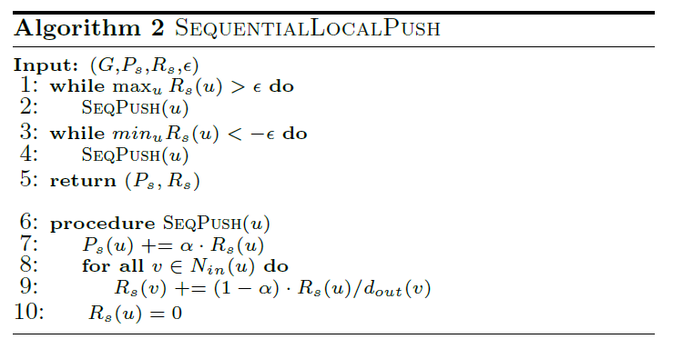
Parallel Personalized PageRank on Dynamic Graphs
Sequential Local Update
restore invariants
perform local pushes

Slide 9
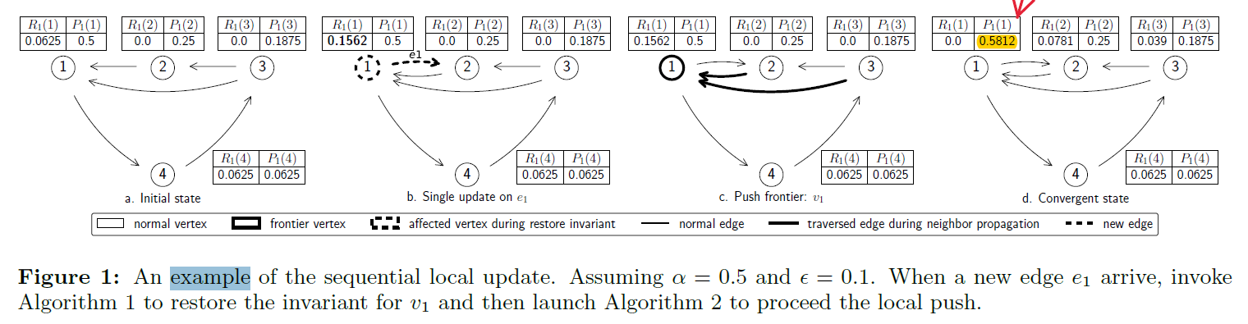
Parallel Personalized PageRank on Dynamic Graphs
Sequential Local Update
example

Slide 10
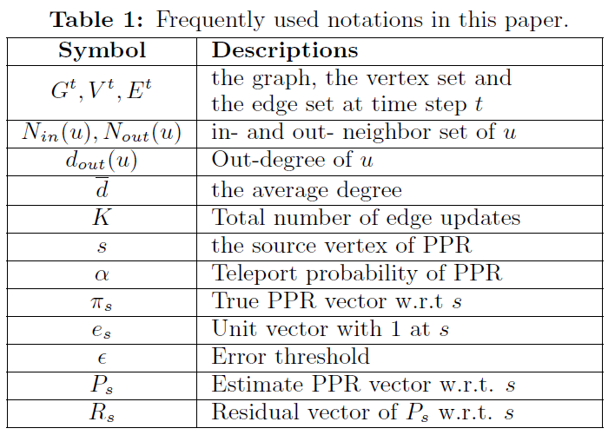
Parallel Personalized PageRank on Dynamic Graphs
Parallel Local Update

Slide 11
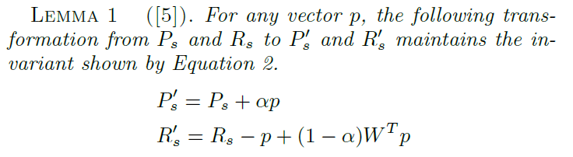

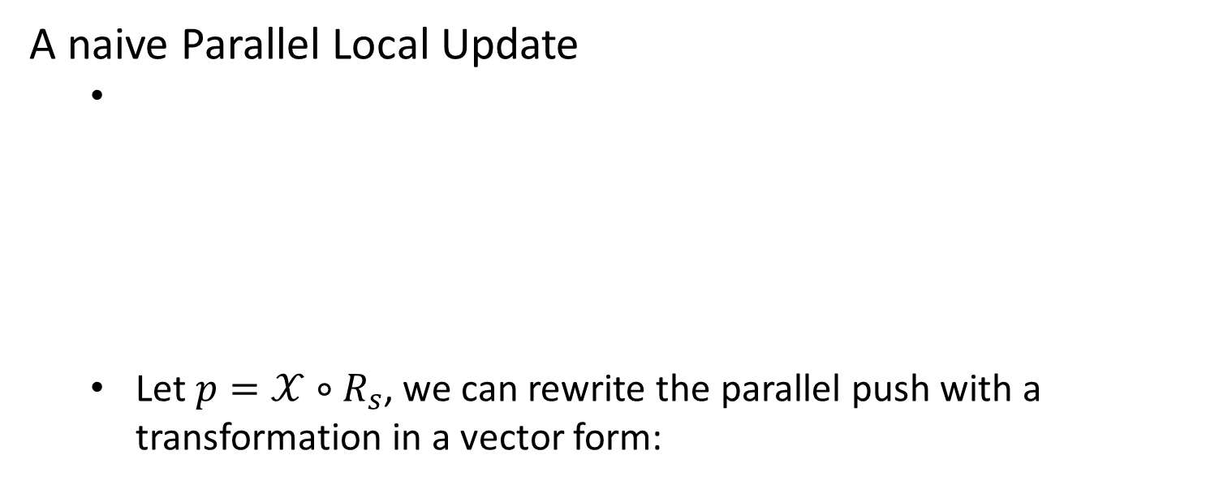
Parallel Personalized PageRank on Dynamic Graphs
A naive Parallel Local Update
Let $p=𝒳∘R_{s}$, we can rewrite the parallel push with a transformation in a vector form:

Slide 12
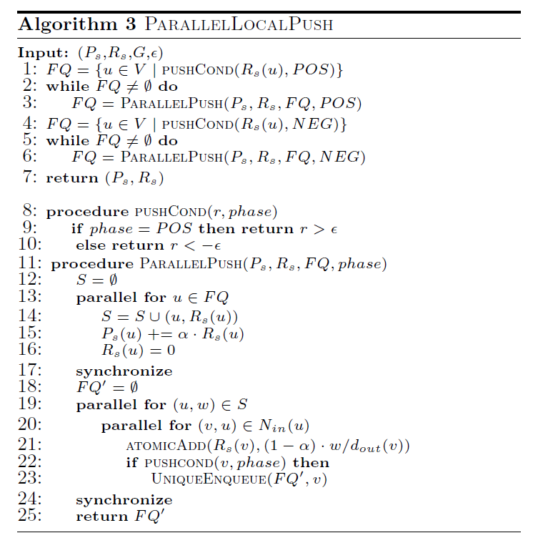
Parallel Personalized PageRank on Dynamic Graphs
A naive Parallel Local Update

Slide 13
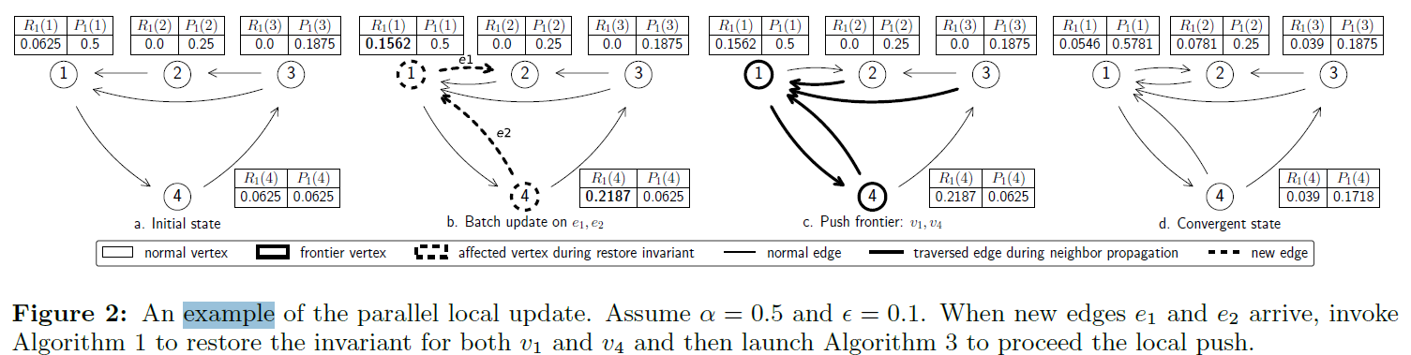
Parallel Personalized PageRank on Dynamic Graphs
A naive Parallel Local Update
example

Slide 14
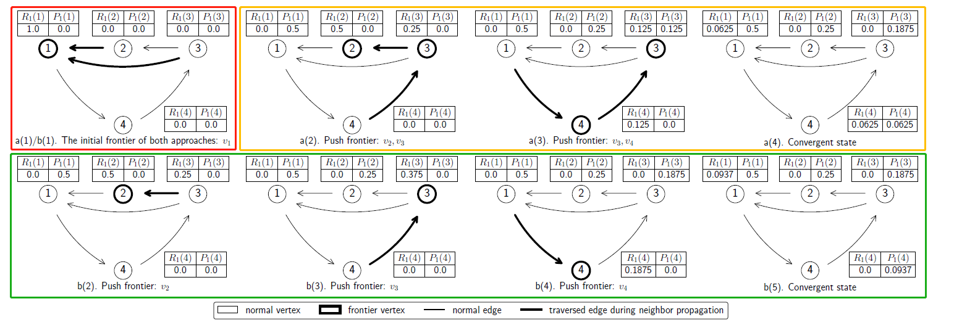
Parallel Personalized PageRank on Dynamic Graphs
Parallel Local Update
Parallel Loss

Slide 15
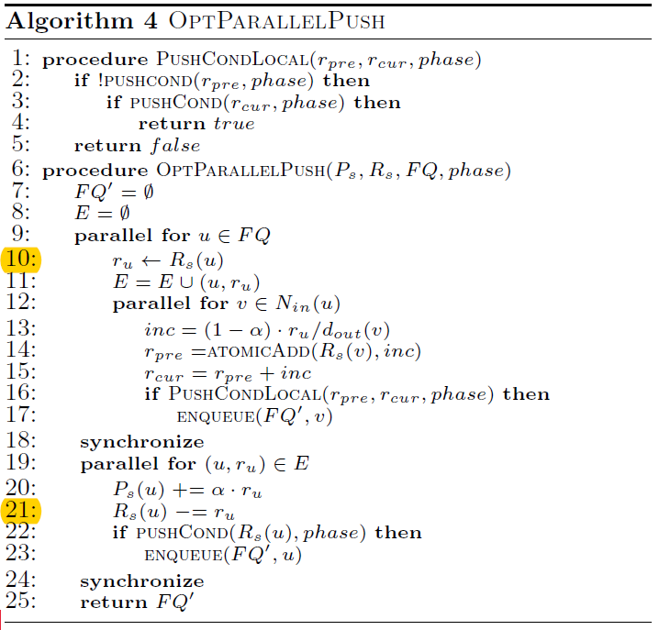
Parallel Personalized PageRank on Dynamic Graphs
Parallel Local Update
Eager Propagation
alter the order of the two parallel sessions
ensure the residuals of frontier vertices that are used in both sessions to be consistent
Notes:
14-17行，是局部重复值检测

Slide 16
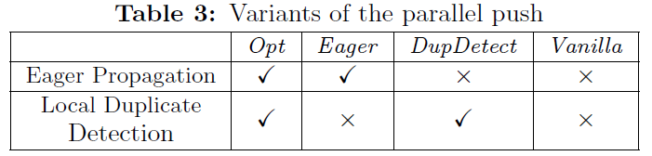
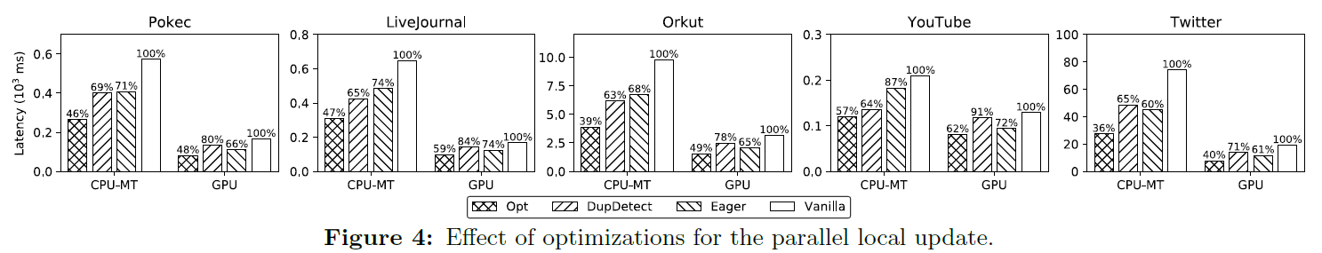
Parallel Personalized PageRank on Dynamic Graphs
Experiments

Slide 17
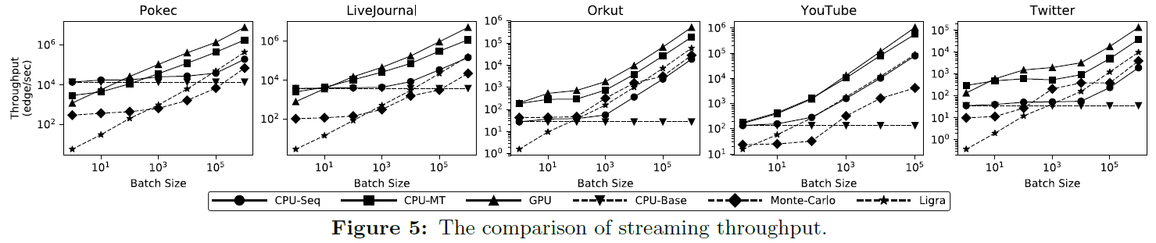
Parallel Personalized PageRank on Dynamic Graphs
Experiments
CPU Sequential Push with Single Update (CPU-Base)
CPU Sequential Push with Batch Update (CPU-Seq)
CPU Parallel Push with Batch Update (CPU-MT)
GPU Parallel Push with Batch Update (GPU)
Incremental Monte-Carlo on CPU (Monte-Carlo)[10, 24]
Vertex-centric implementation in Ligra (Ligra)[42]

Slide 18
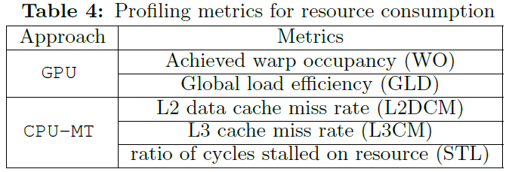
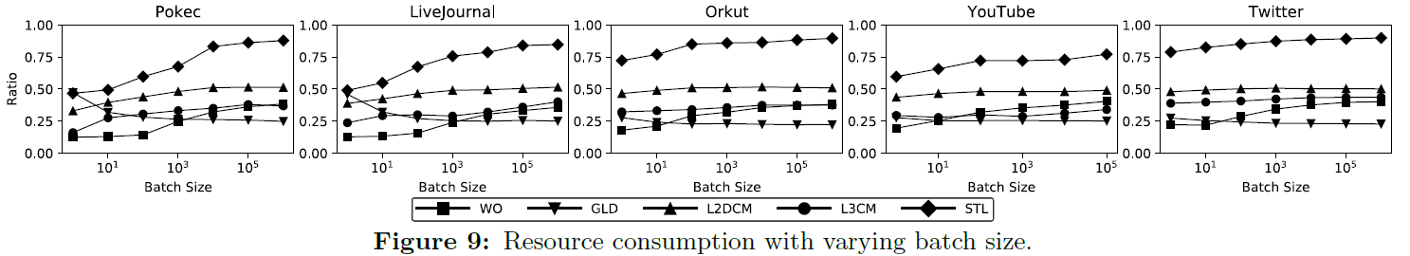
Parallel Personalized PageRank on Dynamic Graphs
Experiments
Resource Consumption

Slide 19
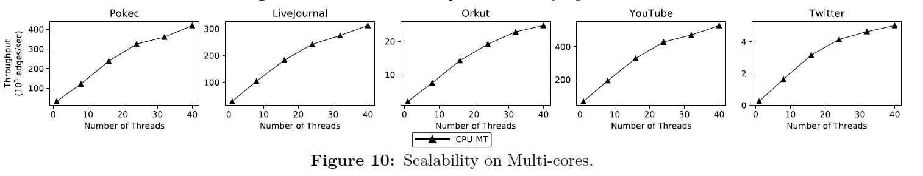
Parallel Personalized PageRank on Dynamic Graphs
Experiments
Scalability

Slide 20
FUTURE WORKS
How to integrate our work with the recent frameworks [14, 41] which can efficiently handle the dynamic scenario by the architecture-optimized graph storage schemes.

